Slide 1

Shri. Shamrao Patil (Yadravkar) Educational & Charitable Trust’s
Sharad Institute of Technology’s College of Engineering ,
Yadrav ( Ichalkaranji)
NBA Accredited Programmes. An ‘A’ Grade Institute Accredited By NAAC, An ISO 9001:2015 Accredited
Department of Computer Science & Engineering
Internship Presentation
Academic Year 2025-26
Name of Student :Sarvesh nitin sogate
PRN:2210104120
Class:Btech[Final Year]
Name of Guide: Mrs.Komal patil

Slide 2

Content
Introduction.
Company/organization details.
Objectives
Plan of Internship Program
Problem Statement
Expected Outcomes
Details of work
Methods, Skills, & Technology Used
Photos

Slide 3
Introduction
I am currently undergoing a 6-month internship as a Data analyst Intern.
Phase- II (6 Month) of my internship has been successfully completed.
During this phase- ll, worked as a data analyst.
The technologies used are Python libraries, Sql ,Excel and poweBI
The project includes features such as Data Analysis, Sales data analysis, Impact Visualization

Slide 4
Company/organization details
Company/Organization: paarsh infotech pvt, Ltd
Internship Address: second floor, c-206, bhumkar das gugre rd, near Bhumkar chowk , wakad
City: wakad (Pune) State: Maharashtra
Pin:411057
Phone:9156799089 Email:hr@paarshinfotech.com
Turnover of Company/Organization:3cr
Name of Industry mentor for internship: Mrs.Harshada ahire
Job Title: Data analyst intern
Mobile No.:7219132393 Email:sarveshsogate8983@gmail.com
Internship Date: from: 20 / 12 /2025 to 20/06 /2026
Hours per Week:45 hours Internship: Unpaid

Slide 5
Internship objectives
Improve data visualization and storytelling skills
To understand the working of a real IT organization.
To gain hands-on experience in collecting,cleaning, preparing and visualize data.
learn to use tools like Excel,SQL,python, power BI
Identify trends, patterns, and insights to support business decisions
To improve data visulization
To work with databases and understand business problems.

Slide 6
Plan of Internship Program
Project Assigned: Products and sales analysis
Planned Modules and Technologies:
Data Preprocessing Module
Purpose: To clean, organize, and transform raw data into a consistent and usable format for accurate analysis.
Technologies/Tools:
Python (pandas, numpy)
Exploratory Data Analysis (EDA) Module
Purpose: To examine the data and extract meaningful insights.
Technologies/Tools:
Python (matplotlib, seaborn)
Dashboard and Visualization Module
Purpose: To present insights in an easy-to-understand visual format.
Technologies/Tools:
Power BI
Excel/CSV as data source

Slide 7
Problem Statement
Analyze customer behavior, forecast sales, and optimize inventory to improve profitability.

Slide 8
Expected Outcomes
Clean and well-structured dataset ready for analysis.
Identification of customer buying patterns.
Accurate sales trends and future sales forecasts.
Improve decision making based on data insights.
Increased overall profitability and efficiency.

Slide 9
Details of work
Collect historical sales and customer data.
Clean and preprocess the data.
Perform exploratory data analysis (EDA).
Analyze customer behavior and sales trends.
Forecast future sales.
Visualize results using charts and graphs.
Generate insights and final report.

Slide 10
Methods, Skills, & Technology Used
Technologies used:
Python
Pandas
Numpy
Matplotlib
Excel(Datasets)
Power BI

Slide 11
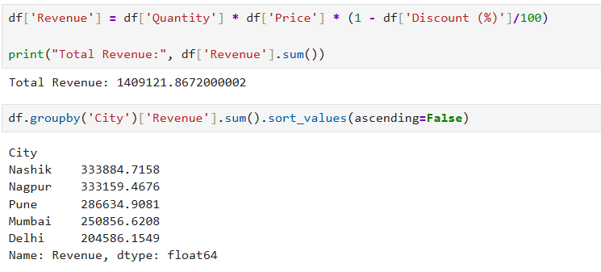
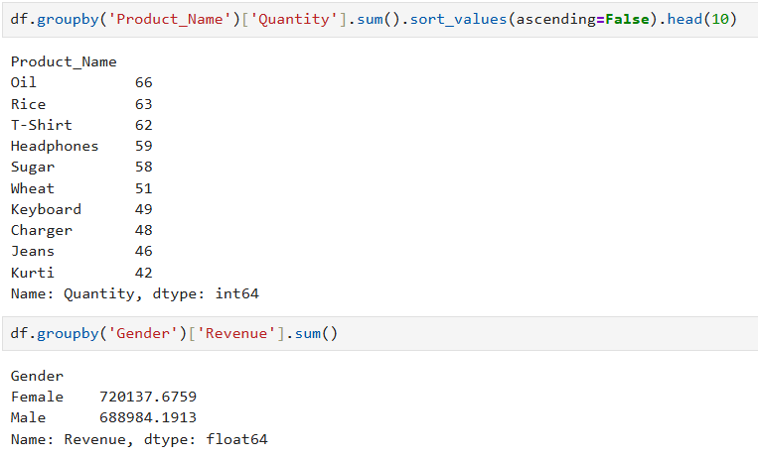
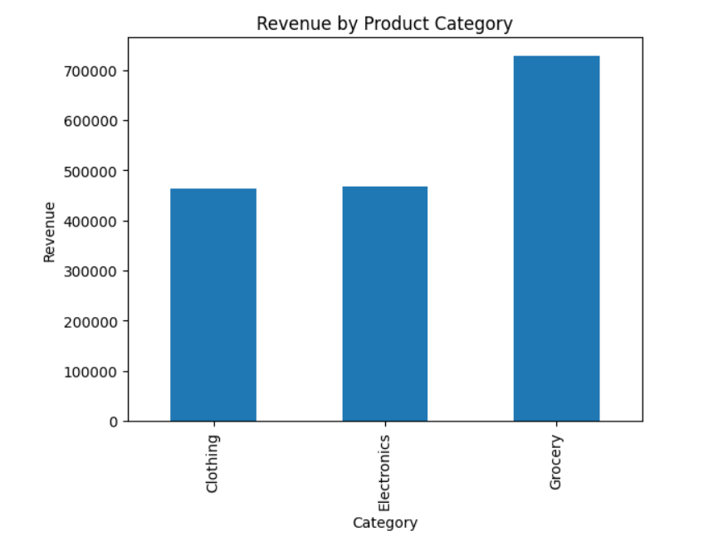
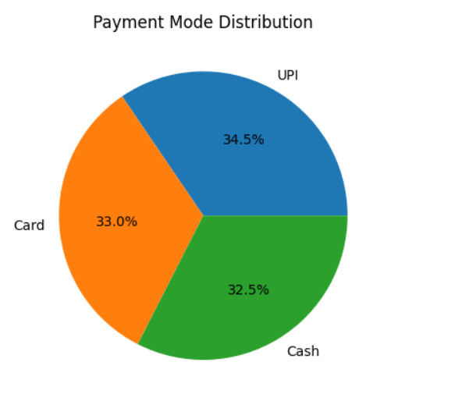
python analysis (EDA):

Slide 12
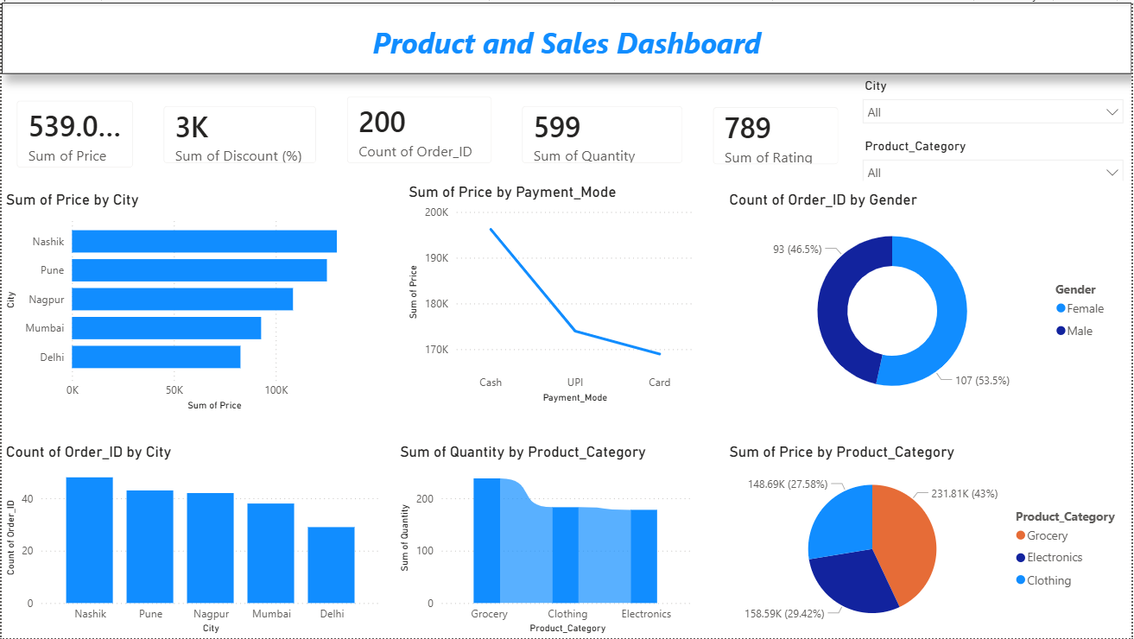
Power BI Dashboard :

Slide 13
Thank You

